Slide 1

JWT WITH SSL

Slide 2
Why use SSL with JWT
JSON Web Tokens (JWT) are often used with HTTPS for several important reasons.
​Firstly, HTTPS provides a secure, encrypted connection between the client and the server, ensuring that sensitive information, such as JWTs, is protected from eavesdropping and tampering during transit. This encryption prevents attackers from intercepting and manipulating the JWT, thus maintaining the integrity and confidentiality of the token.
Secondly, JWTs are often used for authentication and authorization purposes. When used in conjunction with HTTPS, they provide an extra layer of security for transmitting user identity and access information. This is especially crucial in protecting sensitive user data and preventing unauthorized access to secure resources.
Additionally, using JWT with HTTPS helps to prevent man-in-the-middle (MITM) attacks, where an attacker intercepts and modifies communication between the client and the server. HTTPS ensures that the JWT is securely transmitted, preventing potential security vulnerabilities and risks associated with unauthorized access and data breaches.
In summary, the combination of JWT with HTTPS provides a robust and secure framework for transmitting authentication and authorization information, safeguarding sensitive data, and mitigating various security threats.

Slide 3
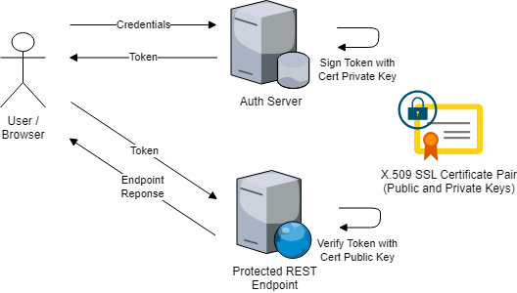

Slide 4
What are some potential security vulnerabilities that can be prevented by using JWT with HTTPS?
Using JSON Web Tokens (JWT) in conjunction with HTTPS can help prevent several potential security vulnerabilities. ​By leveraging the combination of JWT and HTTPS, organizations can mitigate the following threats:
Token Tampering: HTTPS ensures that the JWT is transmitted securely between the client and server, guarding against tampering or modification during transit. This prevents malicious actors from intercepting and altering the token, maintaining its integrity and authenticity.
Eavesdropping: HTTPS encrypts the communication channels, preventing unauthorized parties from eavesdropping on the JWT exchange. This protects sensitive user and authentication data from being intercepted and exploited by attackers.
Man-in-the-Middle (MITM) Attacks: HTTPS safeguards against MITM attacks by securing the transmission of JWTs, reducing the risk of unauthorized interception and manipulation of the token data.
Data Confidentiality: HTTPS encryption ensures that the content of JWTs remains confidential during transmission, preventing unauthorized access to sensitive information contained within the token.
Authentication and Authorization Security: JWTs, when transmitted via HTTPS, provide a secure method for authentication and authorization, guarding against unauthorized access to protected resources and sensitive user data.
By using JWT with HTTPS, organizations can fortify their authentication and authorization processes, thwarting potential security vulnerabilities, and bolstering the overall security of their systems and data.

Slide 5
Combine SSL/TLS and JWT: Ensure that your application endpoints are secured using both SSL/TLS and JWT authentication. This means that clients must use HTTPS to communicate with your server, and they must include a valid JWT token in their requests.
Here's a simplified example of how you can configure SSL/TLS and JWT authentication in a Spring Boot application:
@Configuration
@EnableWebSecurity
public class SecurityConfig extends WebSecurityConfigurerAdapter {
@Autowired
private JwtTokenProvider jwtTokenProvider;
@Override
protected void configure(HttpSecurity http) throws Exception {
// Require HTTPS for all requests
http.requiresChannel().anyRequest().requiresSecure();
// Configure JWT authentication
http.csrf().disable()
.sessionManagement().sessionCreationPolicy(SessionCreationPolicy.STATELESS)
.and()
.authorizeRequests()
.antMatchers("/api/authenticate").permitAll() // Allow login endpoint without authentication
.anyRequest().authenticated()
.and()
.apply(new JwtConfigurer(jwtTokenProvider));
}
}

Slide 6
In above example:
requiresChannel().anyRequest().requiresSecure() ensures that all requests are redirected to HTTPS.
JwtTokenProvider is a class responsible for generating and validating JWT tokens.
/api/authenticate is an endpoint that allows users to authenticate and receive JWT tokens.
JwtConfigurer is a class that configures Spring Security to use JWT tokens for authentication.
Make sure to implement JwtTokenProvider and JwtConfigurer according to your application's requirements.
Additionally, you need to provide the implementation for generating and validating JWT tokens, as well as handling user authentication (login) and token generation endpoints. These implementations will depend on your specific requirements and the libraries you choose to use (e.g., jjwt, Nimbus JOSE + JWT, etc.).
Remember to also handle keystore generation and SSL certificate management appropriately in your deployment environment.

